Slide 1


HABIT & MOOD TRACKER
PROGRAMMING FUNDAMENTALS – FIRST SEMESTER PROJECT
GROUP MEMBERS:
ABDUL RAFAY
FATEHA WAQAR
ABEEHA USMAN
SUBMITTED TO: SIR SALMAN RAZA
DEPARTMENT: COMPUTER SCIENCE (BSAI 1ST)

Slide 2

PROJECT OVERVIEW
Objective:
To design a console-based application that tracks daily habits and moods using C++ file handling.
Key Features:
Daily habit entry
Mood tracking
Weekly analysis
Personalized suggestions
Technology Used:
C++ Programming
File Handling

Slide 3
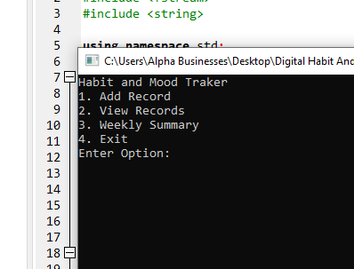
SYSTEM MENU & FLOW
Main Functionalities:
Add Daily Record
View All Records
Weekly Summary
Exit Program

Slide 4
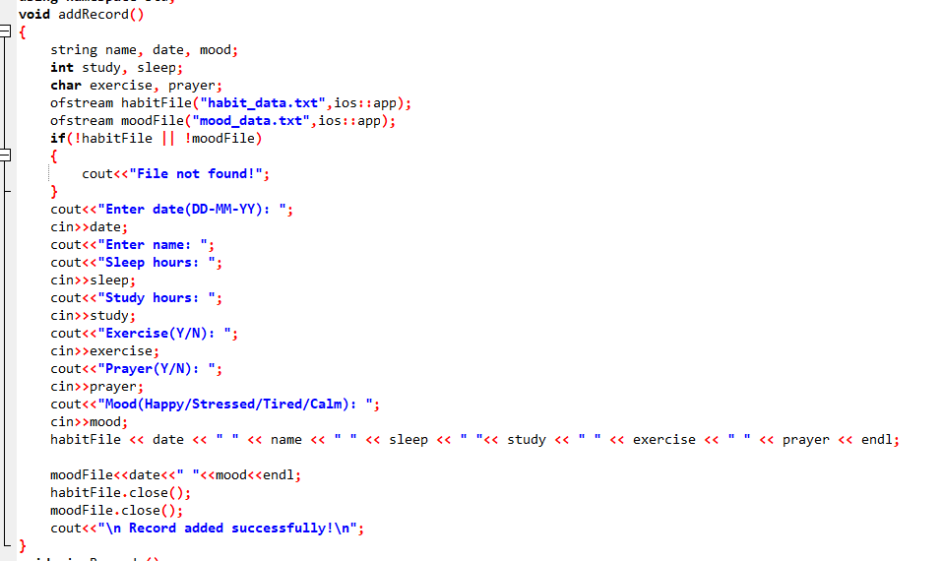
CORE FUNCTION:
ADD RECORD
Function: addRecord()
Purpose:
Takes user input
Stores habit and mood data in files
Files Used:
habit_data.txt
mood_data.txt

Slide 5
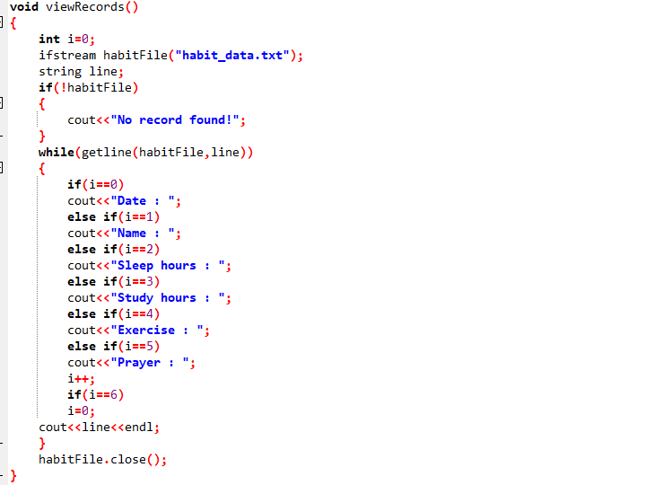
CORE FUNCTION: VIEW RECORDS
Function: viewRecords()
Purpose:
Reads stored habit data
Displays all records to the user

Slide 6
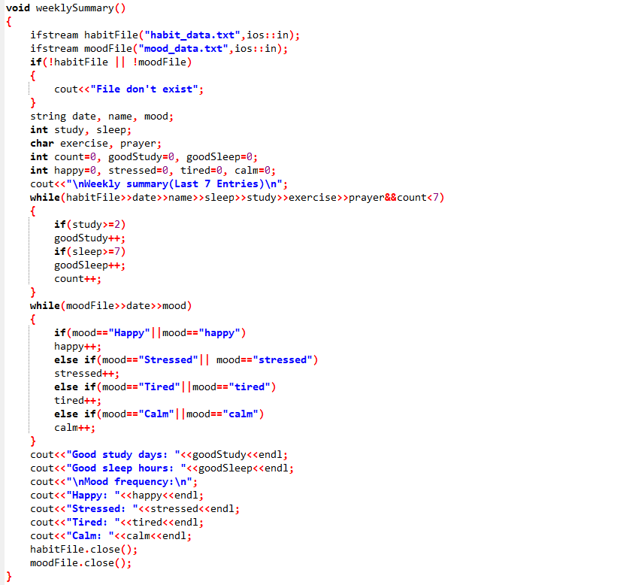
CORE FUNCTION: WEEKLY SUMMARY
Function: weeklySummary()
Purpose:
Analyzes last 7 records
Counts good sleep and study days
Displays mood frequency
Logic Used:
Sleep ≥ 7 hours
Study ≥ 2 hours

Slide 7
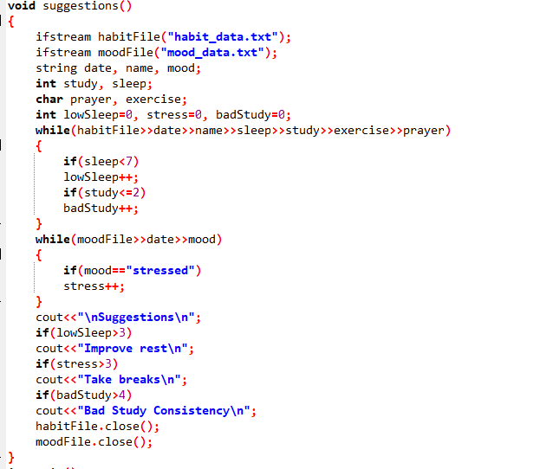
CORE FUNCTION: SUGGESTIONS
Function: suggestions()
Purpose:
Gives improvement tips based on habits and mood
Helps user maintain a healthy routine

Slide 8
FILE HANDLING
Concepts Used
Data Storage
HABIT DATA STORED IN HABIT_DATA.TXT
MOOD DATA STORED IN MOOD_DATA.TXT
FILE CREATION
FILE READING
FILE APPENDING

Slide 9
CONCLUSION
This project demonstrates practical use of:
Functions
Loops and conditions
File handling in C++
Learning Outcome:
Better understanding of C++ fundamentals
Real-life problem-solving using programming

Slide 10
THANK
YOU

